Slide 1

FRIENDLY PASSWORD

Slide 2

APPLICATIONS,SITES,ACCOUNTS… ☹

Slide 3

TIRED OF WASTING YOUR TIME ?

Slide 4
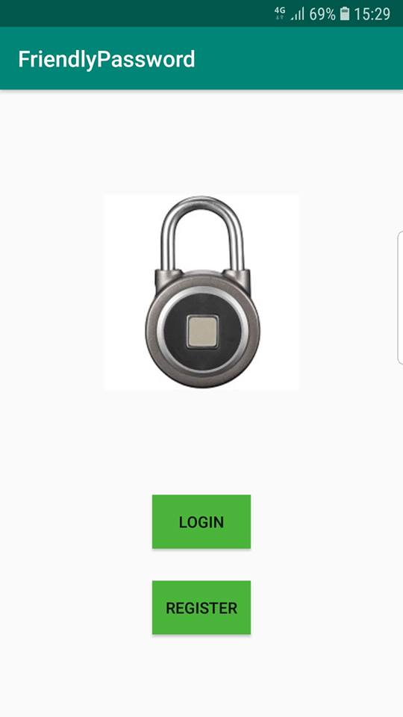
USE FRIENDLYPASSWORD EASY,SECURE,FAST

Slide 5
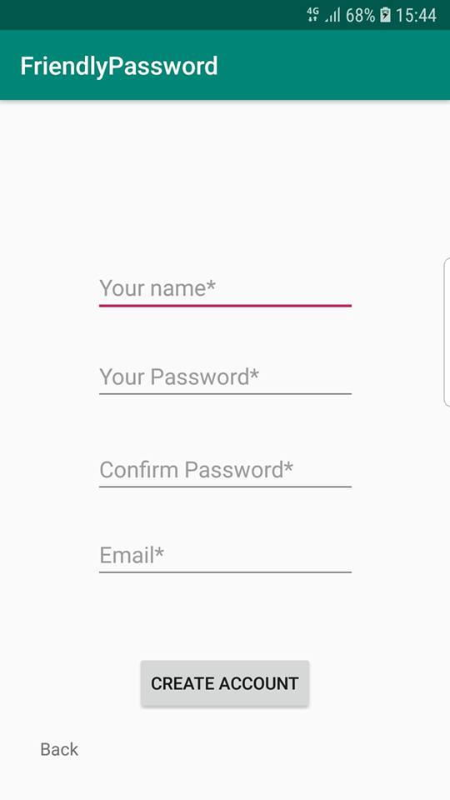

EASY TO REGISTER

Slide 6
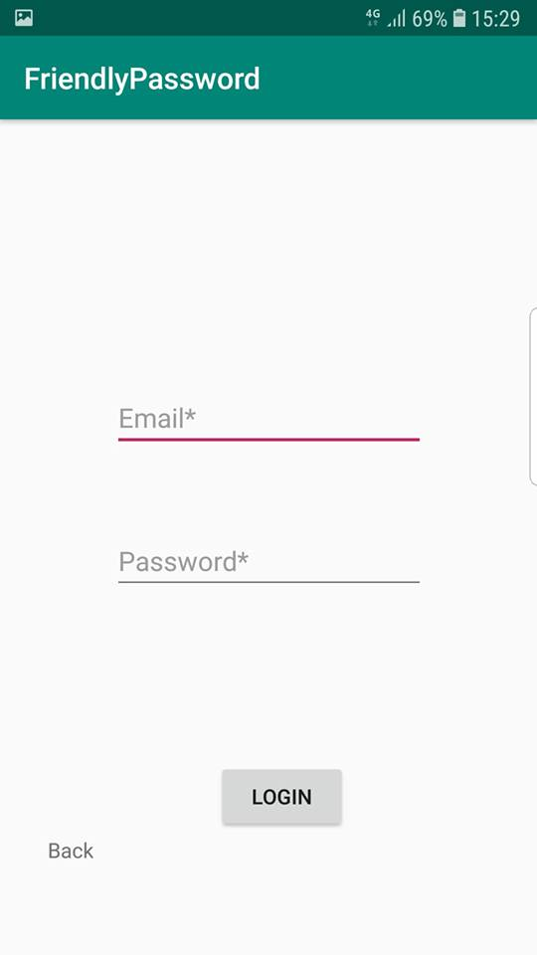
EASY TO LOGIN

Slide 7
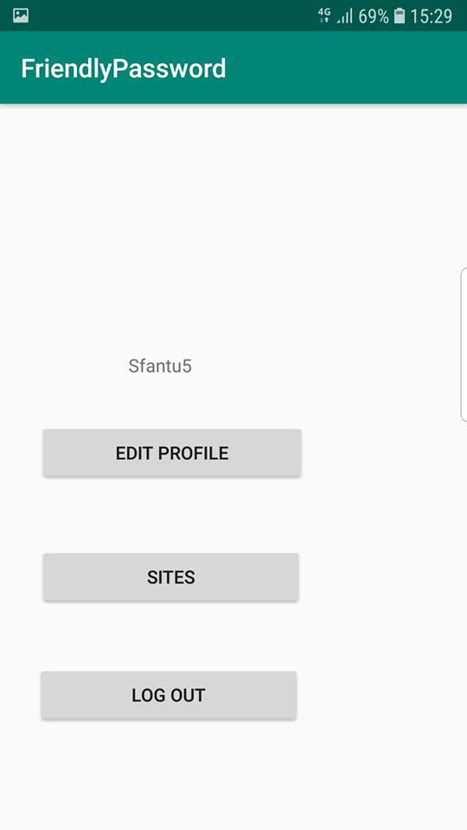
MANAGE YOUR ACCOUNT

Slide 8

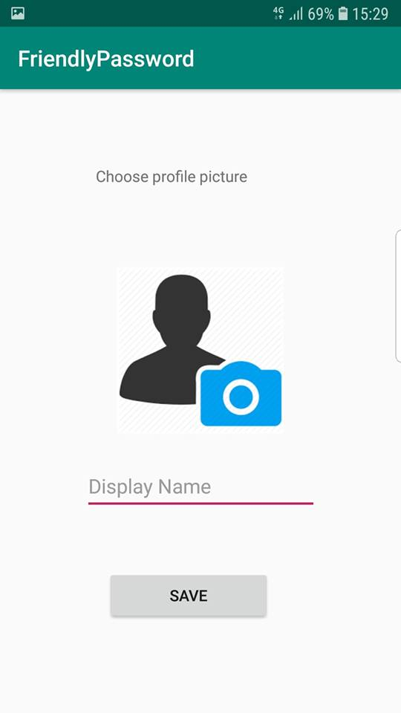
CHANGE PROFILE PICTURE AND NEVER LOOSE THE OLD ONES

Slide 9


SECURE YOUR PASSWORDS AND NEVER FORGET AN ACCOUNT

Slide 10

ACCESS AN APP/SITE EASY AND SECURE ,WITHOUT REMEMBER THE USERNAME & PASSWORD

